Slide 1



Data Scientist Case Study: Direct Marketing Optimization (By Vince Tan)
Objective
Maximize revenue from direct marketing campaigns using the provided dummy data. Business Context: This case study simulates a real-world marketing scenario aimed at optimizing resource allocation to maximize revenue.
Approach
Build 3 propensity models to score how likely a client is to purchase the product.
With the propensity to purchase probability, multiply it with predicted spent/revenue (as this part on predicting spent/revenue is not part of the task, I will use the simple mean instead of a separate model)
Since performance will not be graded and time is limited, I will only use Random Forest which requires minimal data manipulation such as scaling and missing values. Typically I will compare with various models.
With expected revenue for each offer, the maximum revenue and recommended offer can be identified. The top 100 or 15% with the highest revenue can then be selected, giving us the maximum revenue. The application data set ie. those not in the training set, is provided so that we can also identify the highest propensity for individual product.
Workflow
Data Import
Client Socio-Demo
Product
Financial Transactions
Sales and Revenue
Data will be split into Training (those in Sales and Revenue) and Application (for scoring)
EDA, Data Processing and Feature Eng.
New features (Total Asset, Total Liabilities, Net Asset, Gearing, Net Volume)
Drop features (Multi colinear var ie _CA)
Filters (Keep > 21 yo, Drop Tenure 149 to 152)
Models
RandomForest with GridsearchCV
Probability x Predicted Revenue to get Expected Revenue
The offer with highest revenue will be recommended
Next Steps
More data points to help improve model
More variables such as income level, property type, Marital Sts, Historical balances, etc
Conversation with Marketing team on assumptions
Spend more time on EDA, compare other models, investigate important variables

Slide 2
Data Scientist Case Study: Direct Marketing Optimization By Vince Tan
Assumptions
There are many records with Tenure around 150 and Tenure > Age. This could be due to data error, data migration, merger which needs to further investigate. For the purpose of this exercise, we will assume it is data error and records are removed.
Typically marketing will have a set of product requirements such as minimum age that the product can be sold to. We will assume column Client is Account holder and the minimum legal age to be 21. (See slide 3)
In the application data set, there are customers who already has the 3 products, we will assume that customer can have more than 1 of the same product such as having multiple credit cards.
Conclusion
The accuracy of the models are high but the AUC are low. We cannot rely on the accuracy score because the model predict mostly as not buying and the imbalance nature, mostly not buying, lead to a high accuracy score. More work needs to be done to improve the model. This would include:
More data points to help improve model
More variables such as income level, property type, Marital Sts, Historical balances, etc
Conversation with Marketing team on confirming the assumptions
Spend more time on EDA, compare other models, investigate important variables before further training the model
Assuming we are going ahead with this current models and targeting the top 100 customers (usually Marketing will have a budget eg. $200 / $2 dm per customer unit cost = 100 customers), our expected revenue will be 622 (not showing the unit and ccy because it is not given for revenue variable)

Slide 3
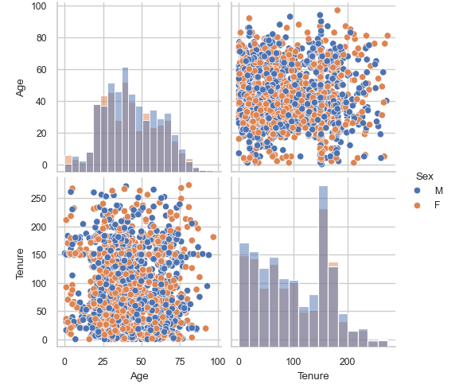
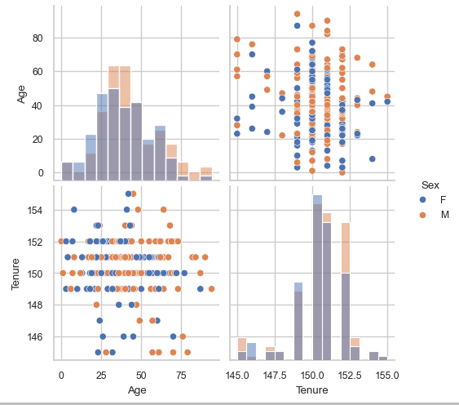
Anomaly: Tenure around 150 and Tenure > Age

Slide 4
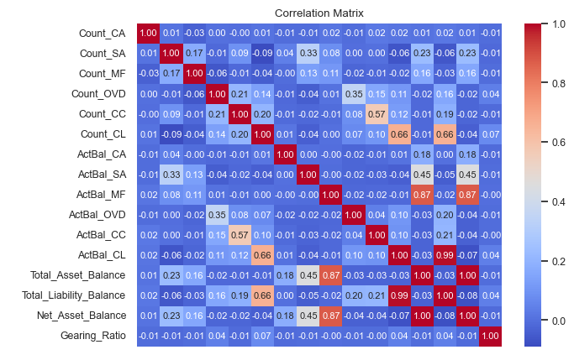
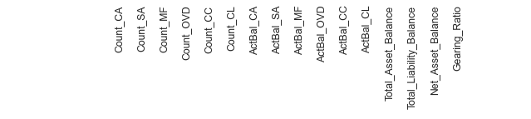
Findings: Products
CA, SA and MF are assets/investments while OVD, CC and CL are more like loans/money owed. From the correlation matrix we can that Client with CA, SA and MF less likely to have OVD, CC and CL and those with CL are also more likely to have CC and OVD.

Slide 5
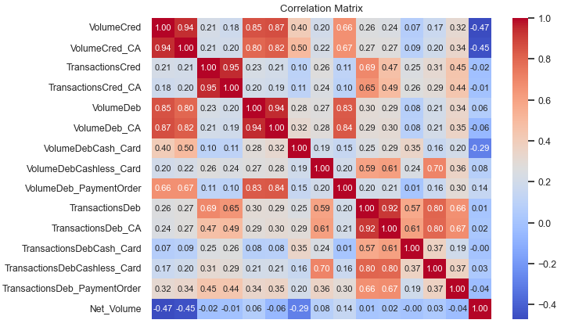
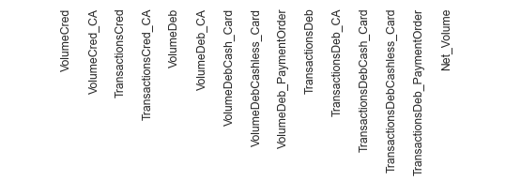
Highly correlated variables: _CA
There are a few variables with _CA that are almost identical ie. multicolinearity and we will drop those above 0.9 ie. the columns suffix with _CA

Slide 6
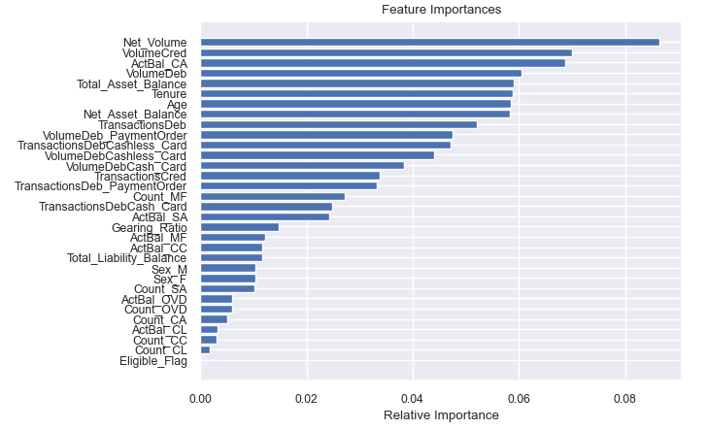
Feature Importance - MF
It is interesting to see the newly generated feature being the most important variable. MF is an investment vehicle and volume may indicate excess funds that can be invested. Further conversation and investigation can be done to understand this insight.

Slide 7
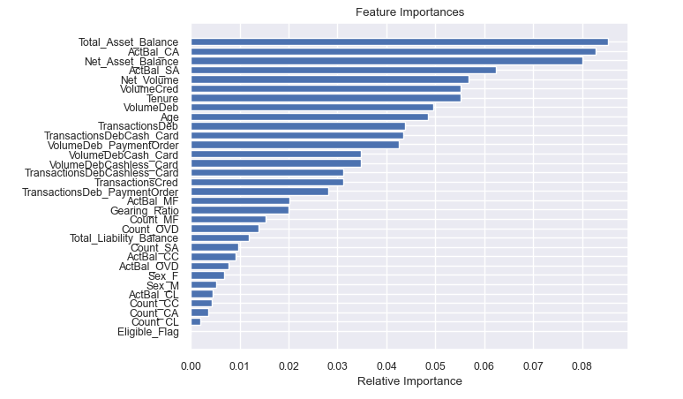
Feature Importance - CC
As people may use Credit Card for ease of purchase and not necessarily because they don’t have the money to pay for good and services, it is interesting to see Asset Balance as the most important variable. Further investigation should be done to determine if it is a positive or negative relationship.

Slide 8
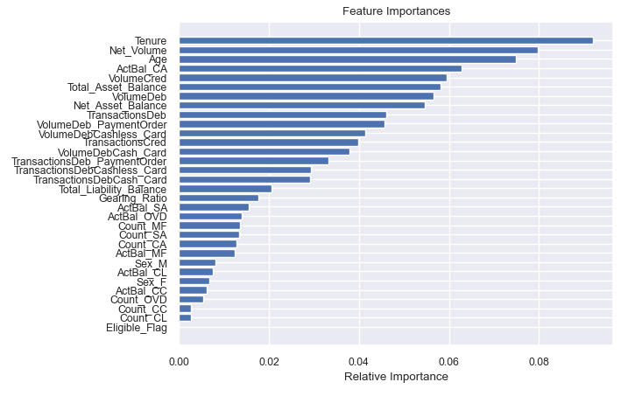
Feature Importance - CL
As this may be driven by the credit risk assessment by the bank, it is not surprising to see Age and Tenure as the most important variable for CL. It would be interesting if we have income or variables indicative of income such as property type among the input variables as that may associate with the Net Volume shown here.

